Slide 1
What are Sexually Transmitted Infections (STI's)
Can you identify types of STI, what puts you at more risk of getting them and how to avoid them?
Can you think how someone could spread an STI without knowing it?

Slide 2
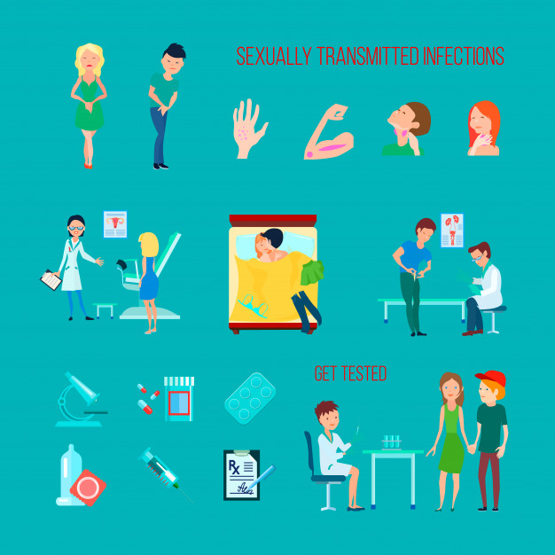
A sexually transmitted infection means an infection a person can get from another person when they do something sexual with that person.
You can only get an STI from someone who has one. You may hear ‘STD or ‘STI’ used out in the world; the ‘D refers to ‘disease,’ and the ‘I’ to infection. There are only small differences between them and we will call them STI’s
Notes:
TEACHER NOTES & IDEAS

Slide 5
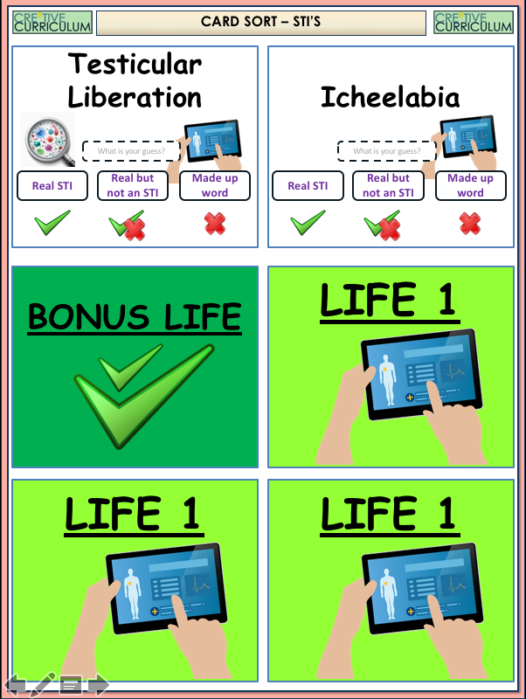
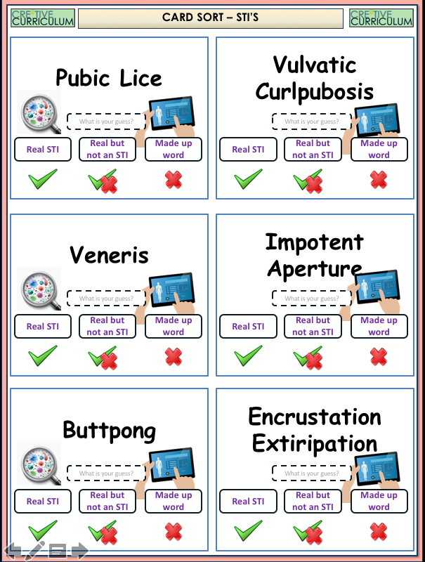
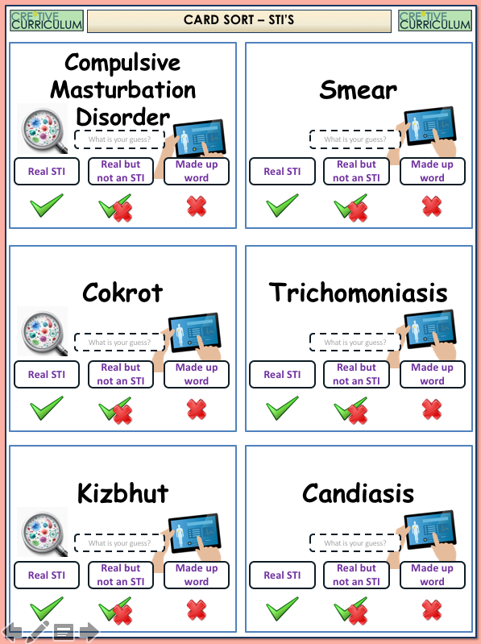
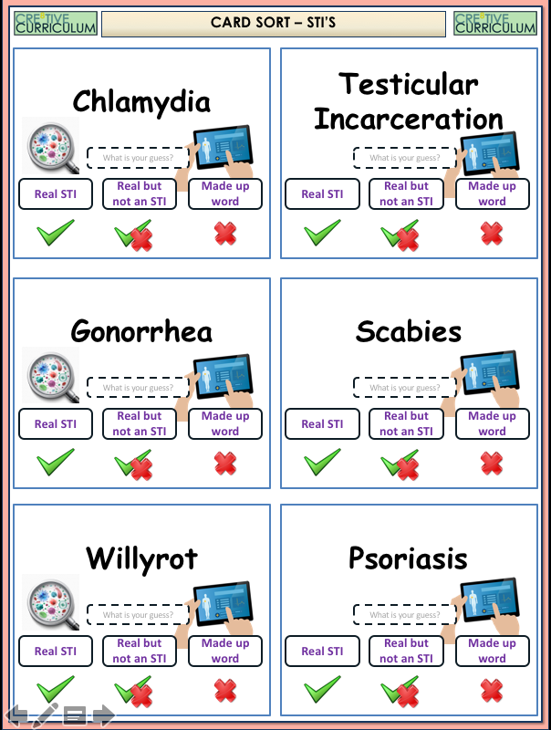
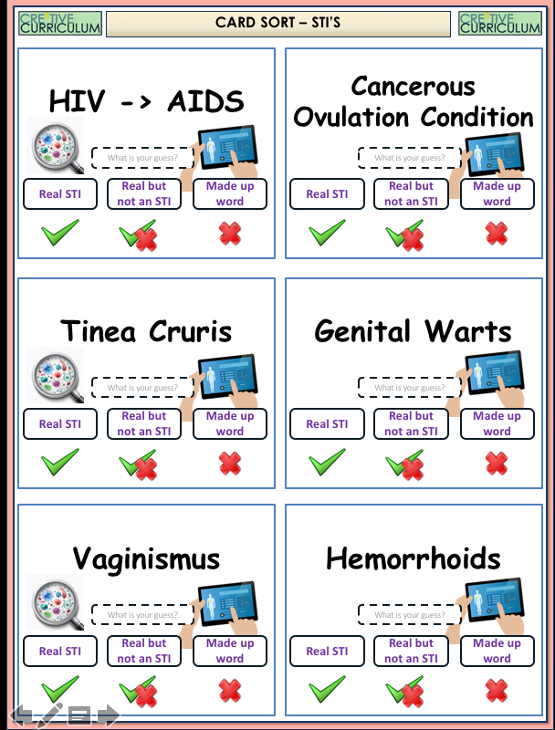
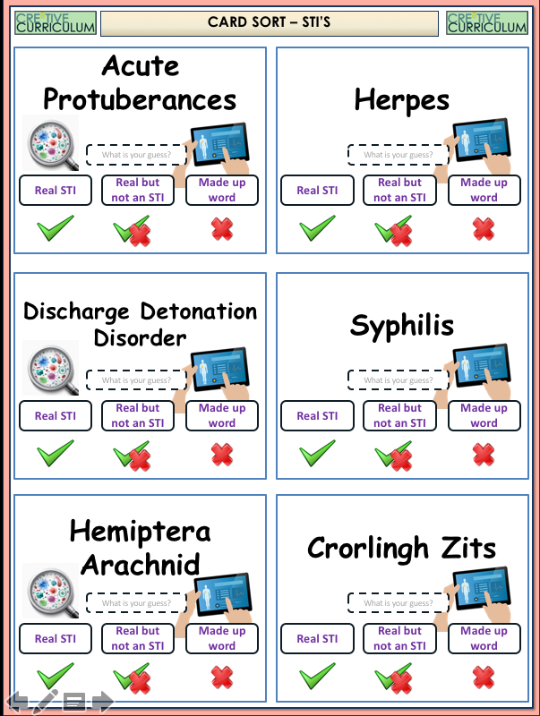
THE BIG STI GUESSING GAME
Look at your cards. Sort them into the 11 STI’s and discard the made up ones.

Slide 6
Which of the Below are not STI’s – 11 of them are real
Hand out cards to students – Click to reveal answers (once lives are lost the game ends!)
STI- Pubic Lice
Pubic Lice
MADE UP
Vulvatic Curlpubosis
It means STI in Latin
Veneris
MADE UP – Known as erectile dysfunction
Impotent Aperture
MADE UP
Pubic Lice
Vulvatic Curlpubosis
Veneris
Impotent Aperture
Buttpong
MADE UP
Encrustation Extirpation
STI - Chlamydia
Chlamydia
MADE UP – Strangulation of a hernia
Testicular Incarceration
STI -Gonorrhoea
Gonorrhea
STI – Scabies
Scabies
MADE UP
Psoriasis
Acute Protuberances
Willyrot
Not STI - It is a skin condition causing a rash
MADE UP
STI -Herpes
Herpes
MADE UP
Discharge detonation disorder
STI - Syphilis
Syphilis
MADE UP
Hemiptera Arachnid
STI - HIV
HIV
Not an STI but a form of ovarian cancer
Cancerous Ovulation Condition
STI- Tinea Cruris
Tinea Cruris
Genital Warts
STI – Genital Warts
STI – Vaginismus or Trichomonas Vagninalis
Vaginismus
Not an STI – but an inflamed muscle tissue
Hemorrhoids
MADE UP
Crorlingh Zhits
Not an STI- But a disorder that does exist
Compulsive Masturbation Disorder
Type of Test women have for cervical cancer
Smear
MADE UP
Cokrot
STI - TRICHOMONIASIS
Trichomoniasis
MADE UP
Kizbhut
Not an STI – another name for Thrush
Candidiasis
MADE UP
Testicular Liberation
MADE UP
Icheelabia

Slide 7
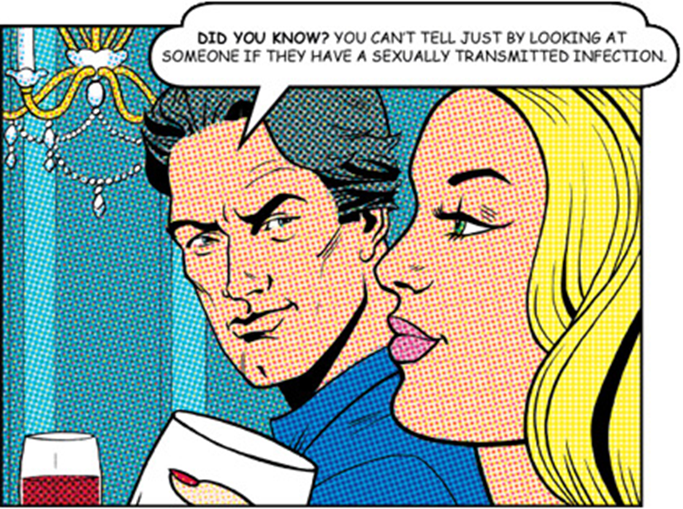
What are the connotations about this statement. Write an answer in your book.
Notes:
TEACHER NOTES & IDEAS
Remind students of the learning journey (What theme you are doing – Possibly recap what they can remember from last lesson.
ATTRIBUTION AND COPYRIGHT
– All icons and logos for Cre8tive Curriculum are created Inhouse by Michael Gillman ©
All images are sourced correctly – mainly through the following sites
either Premium licence at https://www.freepik.com/ or www.Pixabay.com or https://www.pixelscrapper.com/help
Some image have purchased also.
Factual information is not copyrighted.
Where information has been taken from reliable 3rd party websites – it is done so for analytical purposes in small pieces of text and for educational purposes.
Always check the content of any lesson and videos linked before teaching to ensure suitability for your classroom and your school
Further Terms and Condition regarding Copyright and our terms of use can be found on our website here https://cre8tiveresources.com/terms-of-use/

Slide 8
Access to ICT investigation and research..
Use the NHS website to research these different STI's
Gonorrhoea
Chlamydia
write something about...
SYMPTOMS?
TREATMENTS?
EFFECTS OF NOT BEING TREATED?
HOW COULD YOU AVOID CATCHING IT?
Genital Warts
Genital Herpes
Syphilis
HPV

Slide 9
Click on an STI – To find out more…
Bacterial infections
A cure is possible
Viruses
No cure is possible
Chlamydia and Gonorrhoea
Genital Herpes
ALL OTHERS
Genital Warts
Syphilis
HPV

Slide 10
Chlamydia and Gonorrhoea
The facts
Symptoms in women
Caused by bacteria
Spread person to person during sexual activity
Throat infections possible from oral sex
Curable with antibiotics
USUALLY NO SYMPTOMS
But may have...
Vaginal Discharge (fluid)
Burning or pain when peeing
Lowed abdominal Pain
Dangers of it
Symptoms in Men
Can cause infection of the cervix, Pelvic inflammatory disease (PID), Trouble getting pregnant later in life
Irritation when peeing, damage to the testicles, reduction in quality of sperm
USUALLY NO SYMPTOMS
Urethral Discharge (drip)
Burning when peeing
Testicular Pain

Slide 11
Syphilis
The facts
Symptoms in women and Men
Caused by bacteria
Spread person to person during sexual activity
Two stages to the disease
Curable with antibiotics
May have NO SYMPTOMS
But...
Stage 1 – Painless soar anywhere sex occurred
Stage 2 – An infectious brown skin rash across the body
Fever, swollen glands, hair loss and a sore throat
Dangers of it
Infection can continue even in symptoms go away
Serious problems years later (Heart problems, memory loss and stroke-like problems)
It is much easier to catch HIV when infected with Syphilis

Slide 12
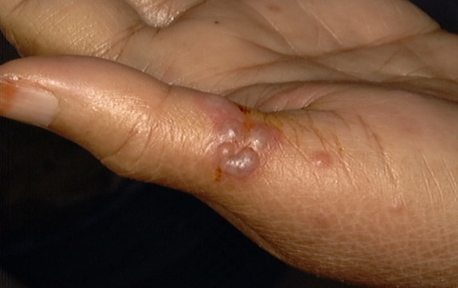
Genital Herpes
The facts
Symptoms in Men and Women
Common 1 in 5 adults
Viral infection of the skin membrane and nerves
The infection will go away and come back
There is no cure -
OFTEN NO SYMPTOMS
But may have...
Ulcers developing in the genital areas
Blistering of the skin
Unexplained pain or sensitive skin
Dangers of it
You could transmit it to someone even if you had no ulcers (herpes) showing
There is currently no cure but medicines can help
It can be passed on through oral sex

Slide 13
HPV and Genital Warts
The facts
Symptoms in women
HPV known as human papilloma Virus
Some types can cause genital warts others can cause cancer (cervix, penis and throat)
Easy to catch Skin to skin contact
Very common- some people can clear their infection without treatment
CAN BE NO SYMPTOMS
But may have...
Small flesh coloured bumps
Mainly occurring on the vulva and other areas of the cervix
Symptoms in Men
Genital warts may require creams, freezing, chemicals and even surgery (still no cure)
Quick detection of HPV (cancerous strain) is essential for best possible treatment(smear tests)
CAN BE NO SYMPTOMS
Small flesh coloured bumps
Mainly occurring on the penis, near the anus or between the penis and the scrotum
Dangers of it

Slide 14
ALL OTHERS
The Names
The Symptoms in men and women
Hepatitis B*
Hepatitis C*
Pubic Lice*
Chancroid
LGV
Trichomonas Vaginalis
Scabies*
Molluscum Contagiousum
CAN BE NO SYMPTOMS
Pain
Blisters
Bumps
Soars
Drip or discharge
Itching Scarring
More likely to get other infections

Slide 15
Discuss for 1 minute the following topics
Did you know?
As many as 70% of women and 50% of men who have an STI, don't show any symptoms.
Someone has a sexually transmitted infection and is sleeping with other people and not telling them
CLICK TO REVEAL
TOPIC OF CONVERSATION 1
Men should always provide a condom before sex
CLICK TO REVEAL
TOPIC OF CONVERSATION 1
Why are STI’s more prevalent in the 16-25 age group
CLICK TO REVEAL
TOPIC OF CONVERSATION 1

Slide 16
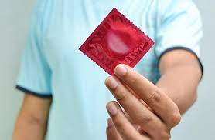
Why is this, so important
in the
prevention of STI’s spreading?

